Slide 1

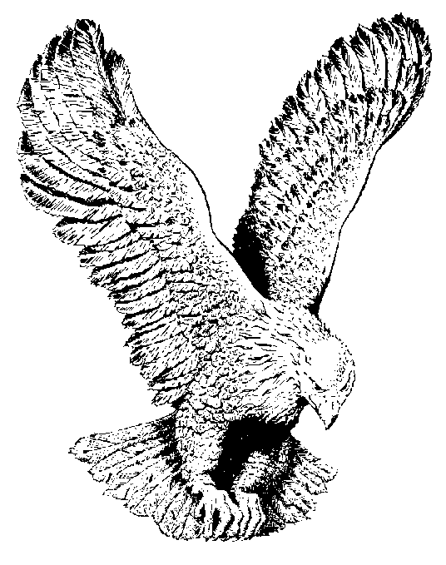
805 MEN WOULD PRAISE THE LORD
Oh, that men would praise the Lord (2x)
For His goodness and for His wonderful works
to the children of men, to the children of men;
He has broken the gates of brass and cut the
bars of iron in sunder,
He has broken the gates of brass and cut the
bars of iron in sunder.

